Slide 1
Object Oriented Programming
Classes and Objects

Slide 2
Topics
Properties
Methods Get/Set for private fields
Accessor get/set
Read Only Properties
Write Only Properties
Auto Implemented Properties

Slide 3
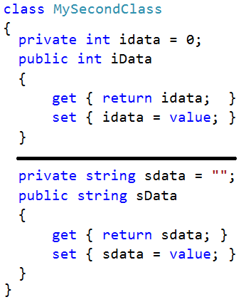
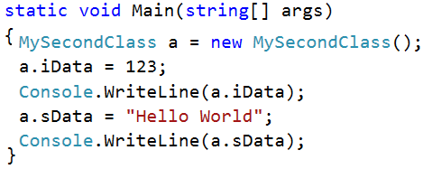
Properties : Accessor get/set

Slide 4
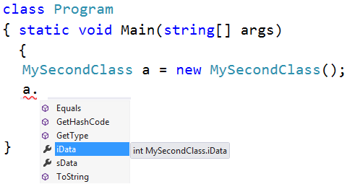
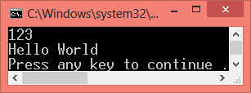
Properties

Slide 5
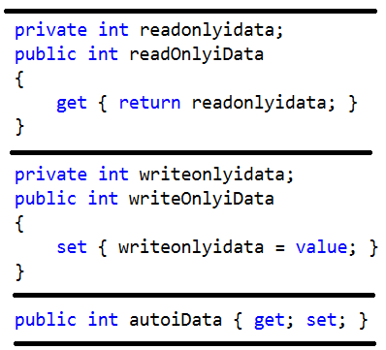
Properties : Read Only / Write Only / Auto

Slide 6
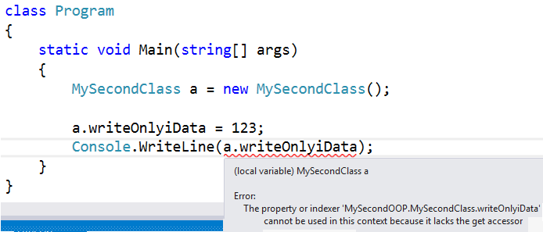
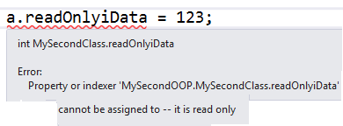
Properties : Read Only / Write Only

